Slide 1


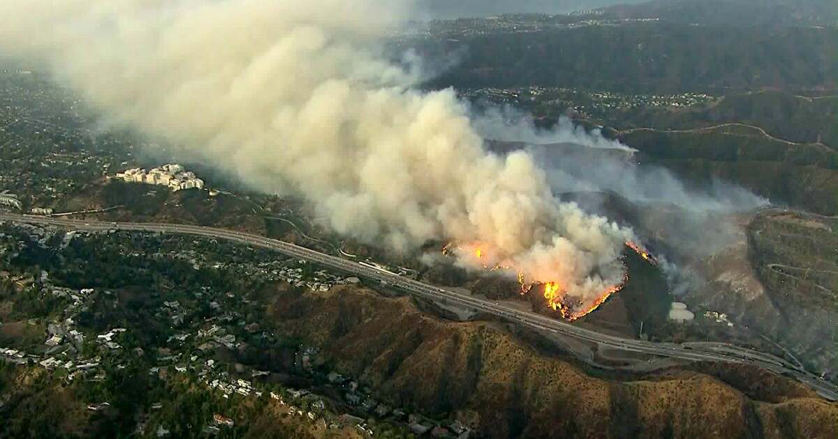
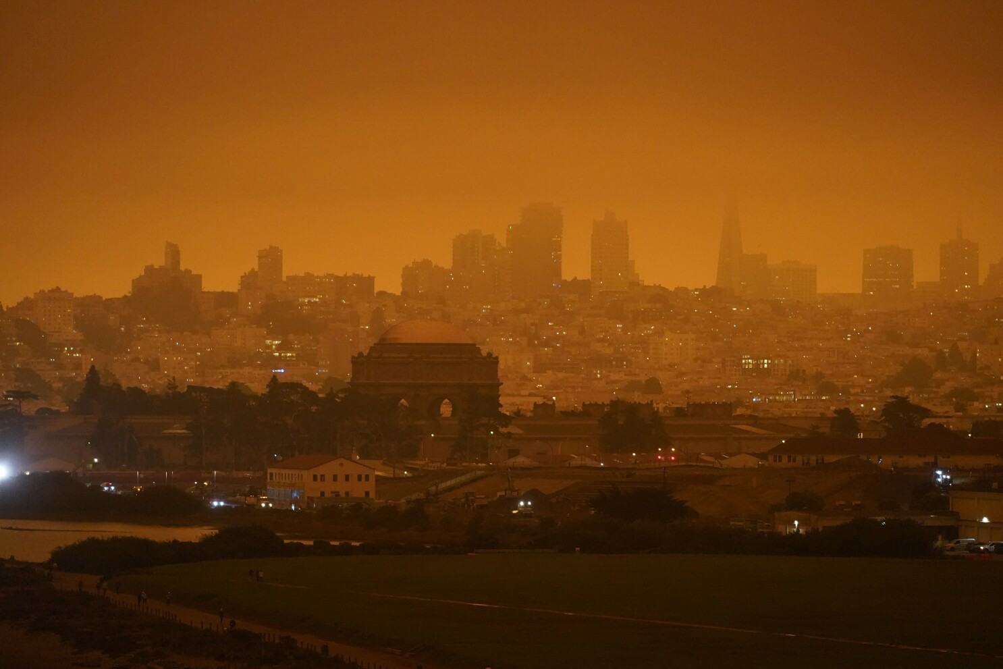


WILDFIRE SMOKE, RESIDENTIAL FIRE PROXIMITY, AND HEALTHCARE USE
IN OLDER ADULTS WHO USE DURABLE MEDICAL EQUIPMENT
Heather McBrien, Sebastian T. Rowland, Tarik Benmarhnia, Sara Y. Tartof, Benjamin Steiger, Joan A. Casey
BACKGROUND
Wildfire-generated PM_{2.5} is associated with worsening of cardiorespiratory disease
People who use electricity-dependent medical equipment may be at high risk from smoke PM_{2.5} exposure
Stress from wildfire evacuation or threatened evacuation may also worsen disease
Though wildfire exposure is multifaceted, few studies focus on exposures other than smoke
DATA
EHR data from 236,732 Kaiser Permanente Southern California members 45+ who rented a medical device, 2016-2020
Counts of outpatient, inpatient, and ED visits, and inpatient and ED visits made for cardiorespiratory concerns by ZIP code
Wildfire PM_{2.5} and non-wildfire PM_{2.5} concentrations from models based on ground sensors and satellite images
CALFIRE wildfire boundary data for the Getty and Woolsey fires; identified all ZIP codes within 20km of each fire
Digitized the evacuation zones from both fires and found all ZIP codes within 10km of either evacuation zone
ANALYSIS
Assessed the relationship between wildfire PM_{2.5} and healthcare use, as well as proximity to wildfire and healthcare use
Linked healthcare visit counts to wildfire PM_{2.5} measurements and used negative binomial models to assess the association between lags 0-7 wildfire PM_{2.5} concentrations and frequency of outpatient, inpatient, and ED visits
We controlled for non-wildfire PM_{2.5} temperature, long-term seasonal trends, and SES-related variables
We used a difference-in-differences approach to assess the association between fire proximity and healthcare use
We used negative binomial models to find the change in visit frequency attributable to proximity or evacuation from either fire
MAIN FINDINGS
1. Wildfire smoke exposure (PM_{2.5}) increased outpatient visits in older adults who use electricity-dependent medical devices.
2. During the notable 2019 Woolsey Fire, older adults who use electricity-dependent medical devices were hospitalized more frequently during the fire for cardiorespiratory problems.
PROXIMITY AND EVACUATION RESULTS
WILDFIRE PM_{2.5} RESULTS
Woolsey Fire Getty Fire
Legend
All-cause outpatient
Inpatient
Emergency
Inpatient cardiorespiratory
Emergency cardiorespiratory
Increased wildfire PM_{2.5} concentration (per 10 𝜇𝑔/𝑚³) was associated with reduced risk (RR = 0.96, 95% CI: 0.94, 0.99) of all-cause outpatient visits one day after exposure and increases on 4/5 subsequent days (RR range 1.03-1.12)
Evacuation
Residential fire proximity
CI
CI
Our study exposure: Woolsey and Getty fire evacuation zones plus 10km buffer. Fire burn areas are in black, and the study area is shaded in grey.
NIA RF1AG071024 (JAC)

